Slide 1
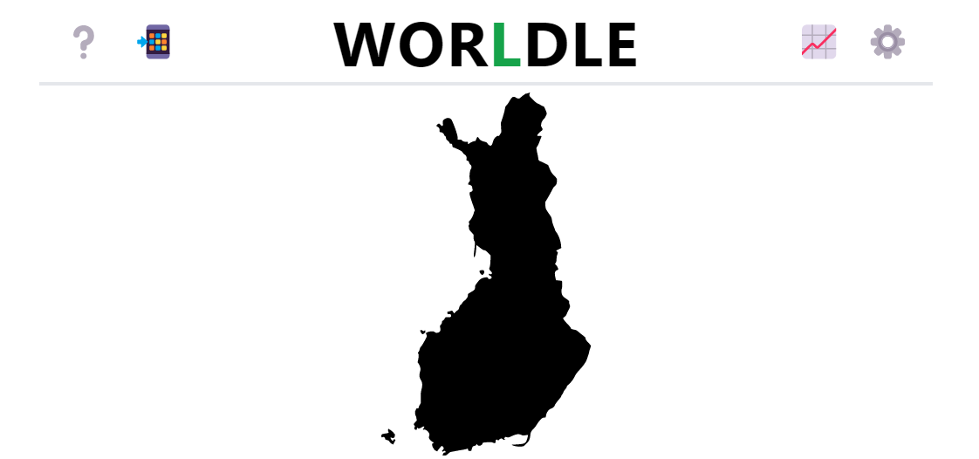
Introduction to Data Visualization
Visualizing Geospatial Data
Halil Bisgin, Ph.D.
https://worldle.teuteuf.fr/

Slide 2
Geospatial Data-Maps
Many datasets contain information linked to locations in the physical world.
A dataset may contain information about where people with specific attributes (covid-19 cases, income, age, political affiliation, etc.)
It can be helpful to visualize the data in their proper geospatial context.
Maps are intuitive, but they can be challenging to design.
The choropleth map represents as differently colored spatial areas.
Cartograms, which may purposefully distort map areas or represent them in stylized form, for example as equal-sized squares.
Notes:
Very useful and at other times quite misleading.

Slide 3
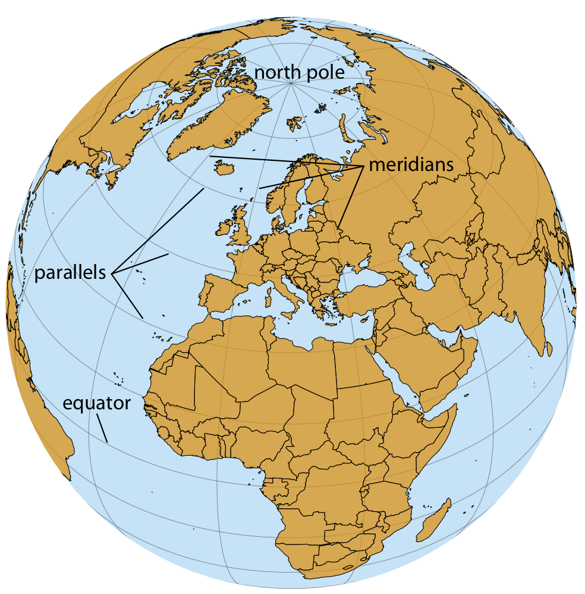
Projections
The earth is an oblate spheroid.
To uniquely specify a location on the earth, we need three pieces of information:
where we are located along the direction of the equator (longitude),
how close we are to either pole when moving perpendicular to the equator (the latitude)
how far we are from the earth’s center (the altitude).
Primarily: longitude and latitude

Slide 4
Longitude and latitude
They are both angles, expressed in degrees.
Degrees longitude: how far east/west a location lies.
Lines of equal longitude are referred to as meridians, which terminate at the two poles.
Degrees latitude: how far north or south a location lies.
Lines of equal latitude are referred to as parallels, since they run parallel to the equator.
All meridians have the same length, corresponding to half of a great circle around the globe, whereas the length of parallels depends on their latitude

Slide 5
Projection
To take the spherical surface of the earth and flatten it out so we can display it on a map.
Can preserve either angles or areas but not both.
A projection that does the former is called conformal and a projection that does the latter is called equal-area
Some projections preserve other quantities of interest, such as distances to some reference point.
Others try to strike a compromise between preserving angles and areas
Standards maintained by organizations:
European Petroleum Survey Group (EPSG) and the Environmental Systems Research Institute (ESRI), maintain registries of projections.

Slide 6
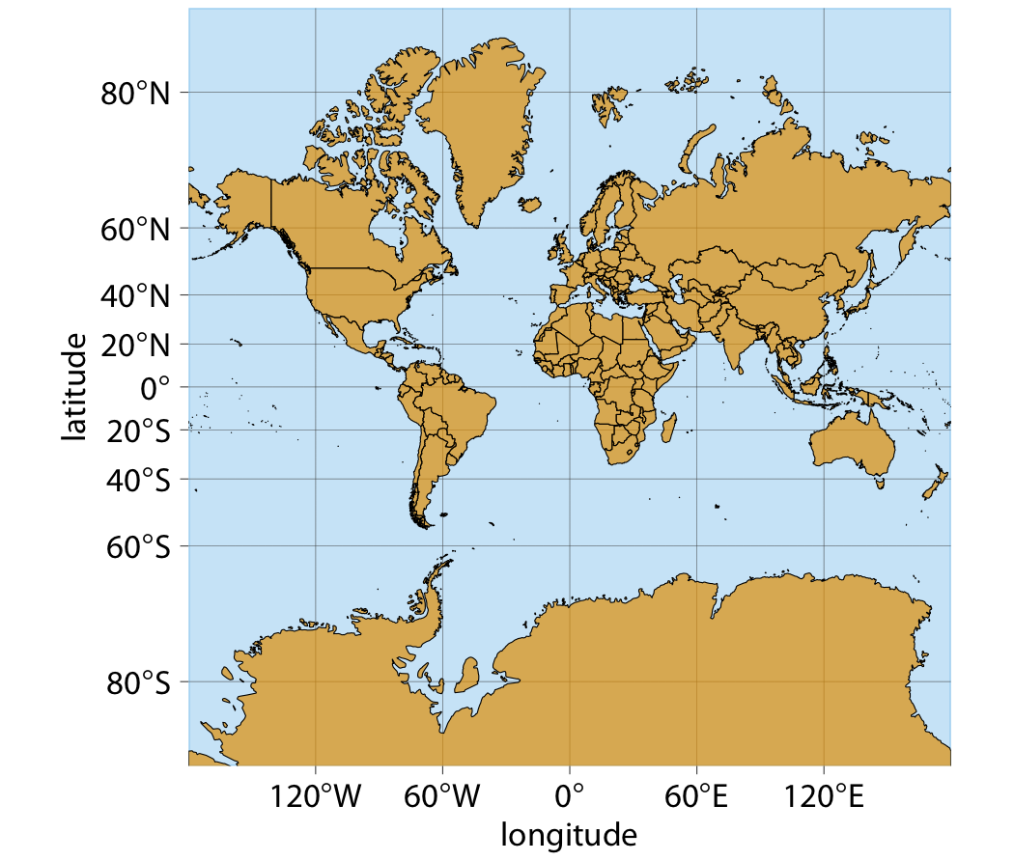
Mercator projection-Not favorite
Conformal projection that accurately represents shapes but introduces severe area distortions near the poles.
Meridians are evenly spaced vertical lines
Parallels are horizontal lines whose spacing increases the further we move away from the equator to make meridians evenly spaced
Notes:
The spacing between parallels increases in proportion to the extent to which they have to be stretched closer to the poles to keep the meridians perfectly vertical.
-still in use to some extent

Slide 7
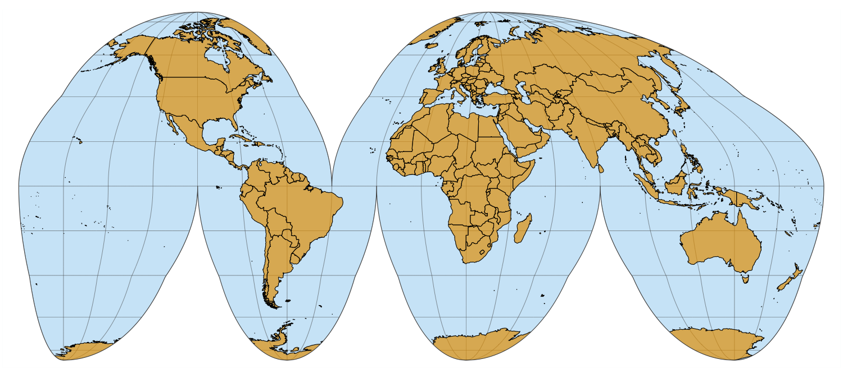
Goode homolosine
Whole-world projection that is perfectly area-preserving
Interrupted form:
one cut in the northern hemisphere and three cuts in the southern hemisphere which don’t interrupt major land masses.
The cuts allow the projection to both preserve areas and approximately preserve angles,
at the cost of noncontiguous oceans, a cut through the middle of Greenland
several cuts through Antarctica.
Notes:
While the interrupted Goode homolosine has an unusual aesthetic and a strange name, it is a good choice for mapping applications that require accurate reproduction of areas on a global scale.

Slide 8
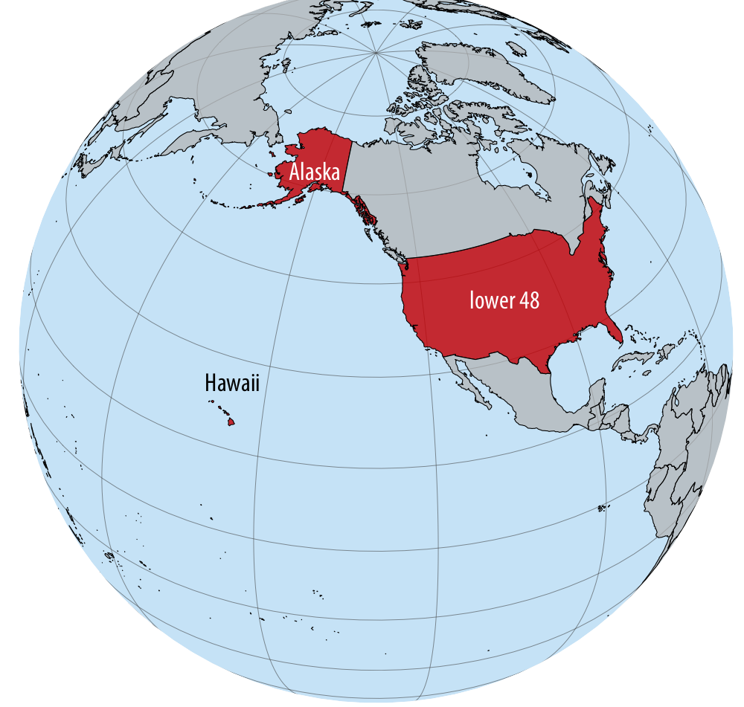
Distortions are at all levels
Shape or area distortions due to map projections are particularly prominent when we’re attempting to make a map of the whole world
They can cause trouble even at the scale of individual continents or countries.
United States, which consists of the lower 48 (which are 48 contiguous states), Alaska, and Hawaii
48 alone are reasonably easy to project
Alaska and Hawaii are so distant
Notes:
While the lower 48 alone are reasonably easy to project onto a map, Alaska and Hawaii are so distant from the lower 48 that projecting all 50 states onto one map becomes awkward.

Slide 9
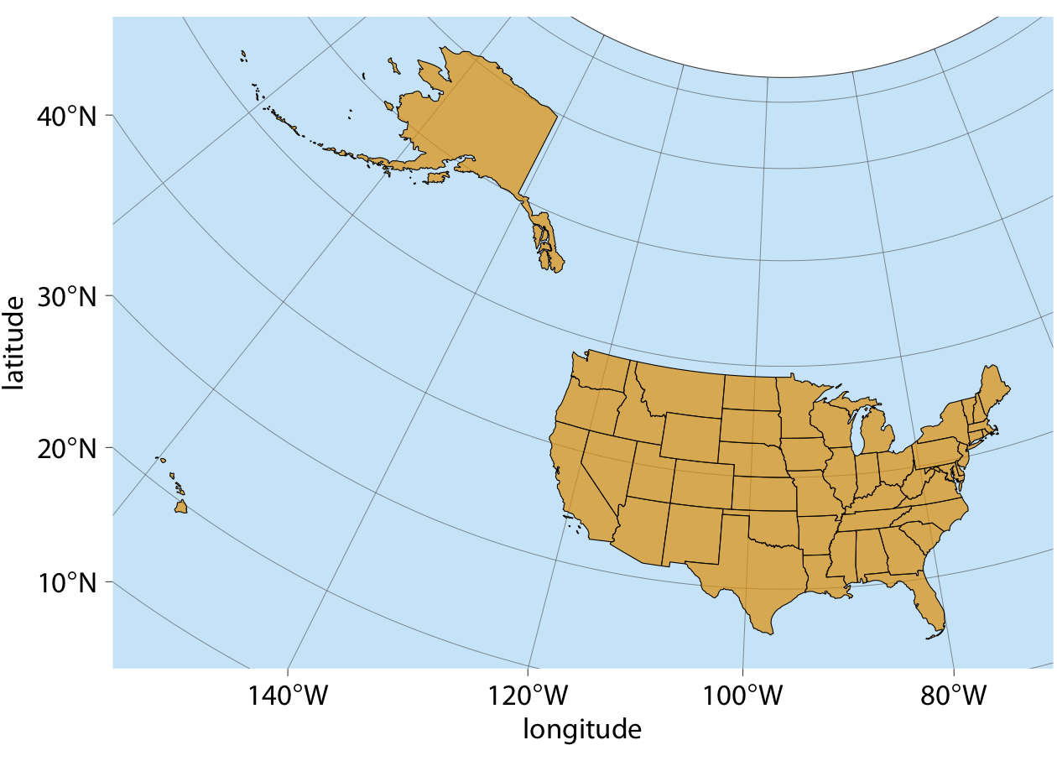
Problems
(Equal-area) Albers projection provides a reasonable representation of the relative shapes, areas, and locations of the 50 states, but still issues.
Alaska seems weirdly stretched out.
Dominated by ocean/empty space

Slide 10
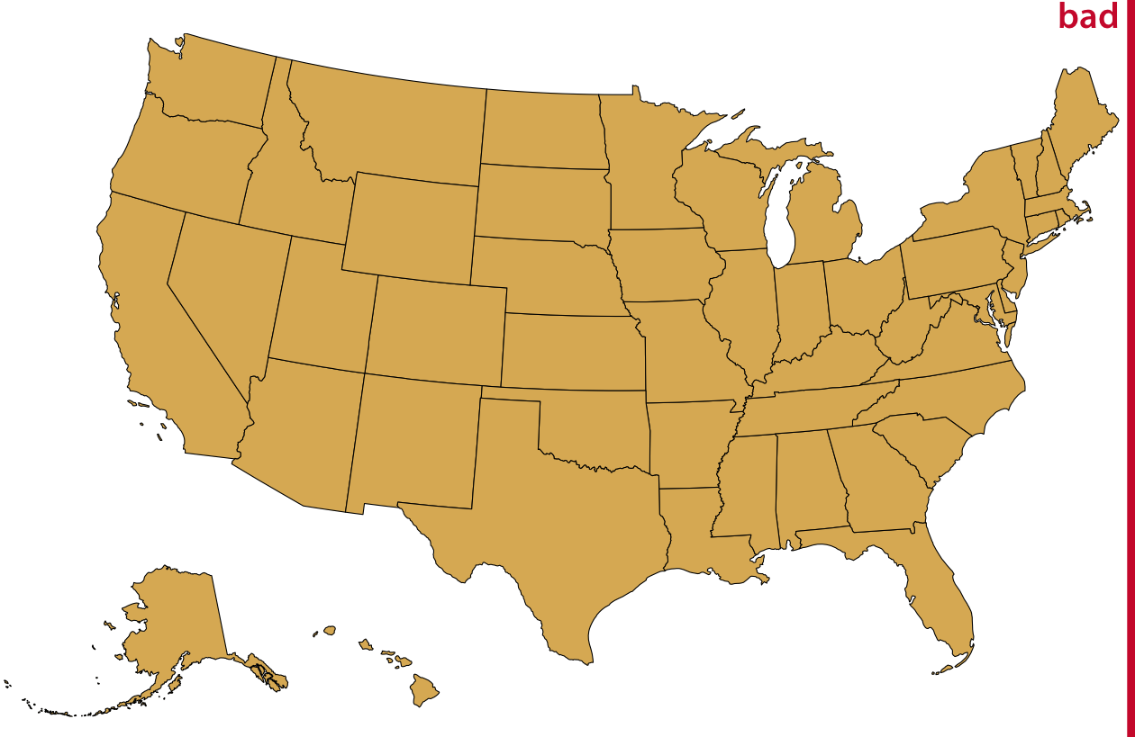
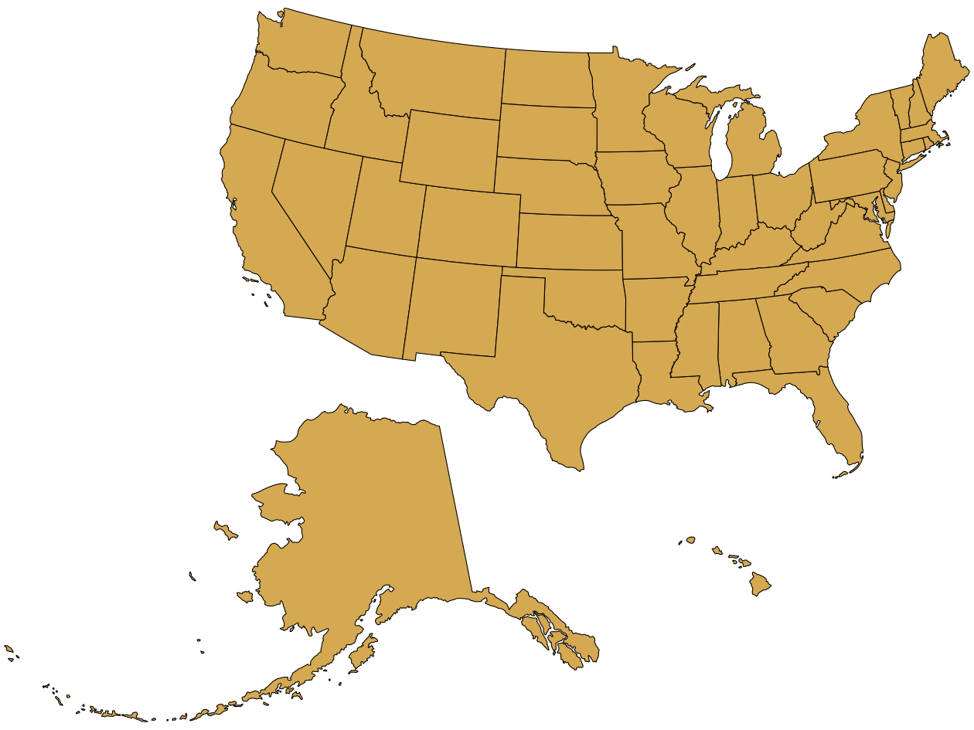
Some improvements
We can project Alaska and Hawaii separately.
Alaska looks much smaller
(misleading)
Reveals that Alaska is the largest state

Slide 11
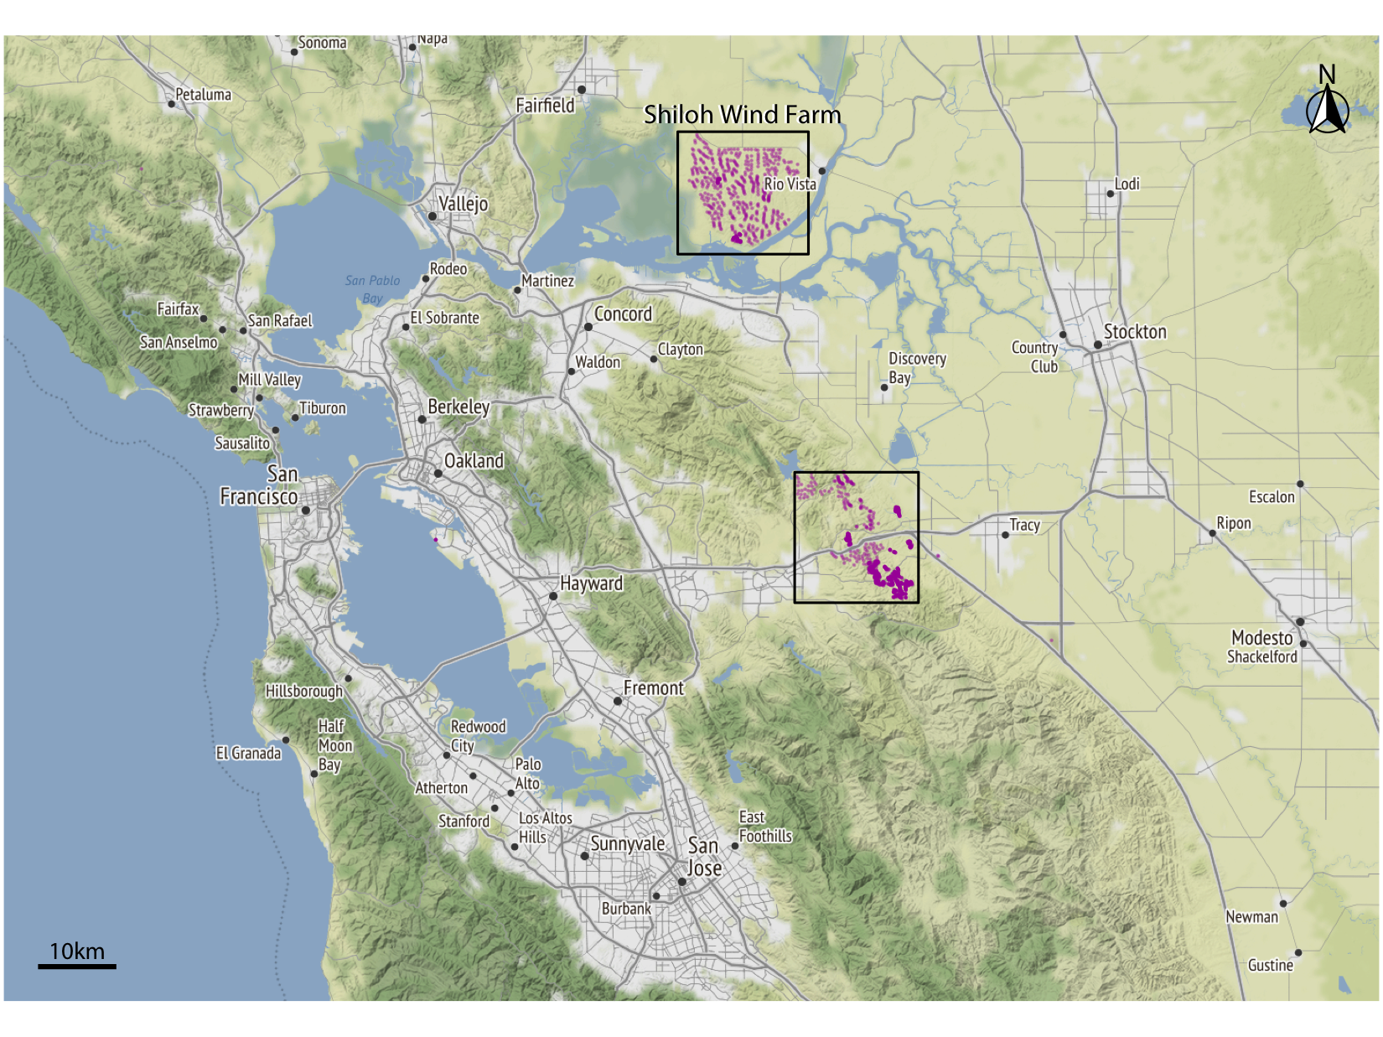
Layers
To visualize geospatial data in the proper context, we usually create maps consisting of multiple layers showing different types of information.
Wind turbines in the San Francisco Bay area

Slide 12
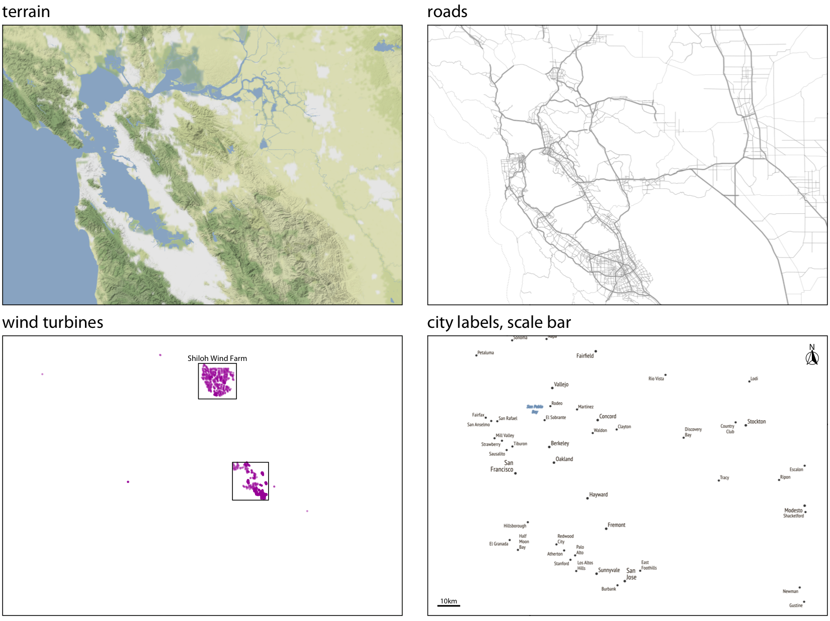
Layers
The terrain layer for hills, valleys, and water
The road network
The locations of individual wind turbines.
The locations and names of cities.

Slide 13
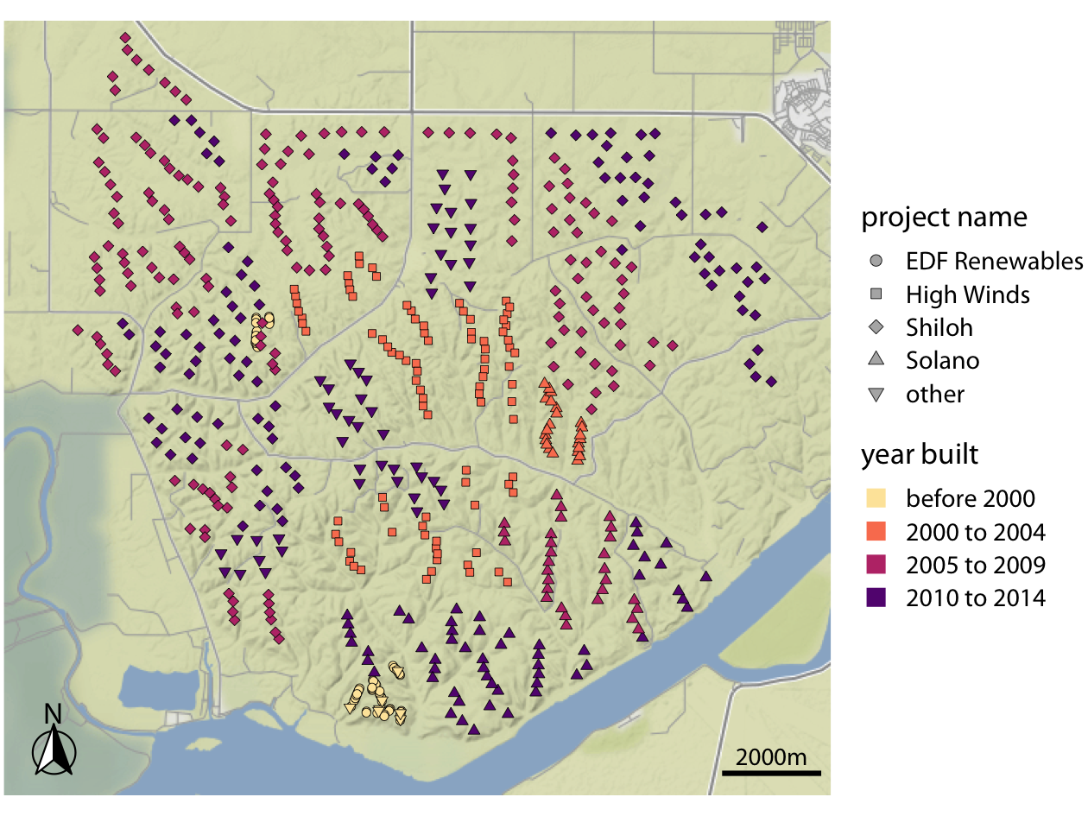
Mapping data onto aesthetics in maps
We can place data points into their geographic context and show other data dimensions via aesthetics such as color or shape
Individual wind turbines are shown as dots,
Color: when a specific turbine was built
Shape: the project to which the wind turbine belongs
Notes:
EDF Renewables is a relatively small project built before 2000, High Winds is a moderately sized project built between 2000 and 2004, and Shiloh and Solano are the largest two projects in the area, both built over an extended period of time.

Slide 14
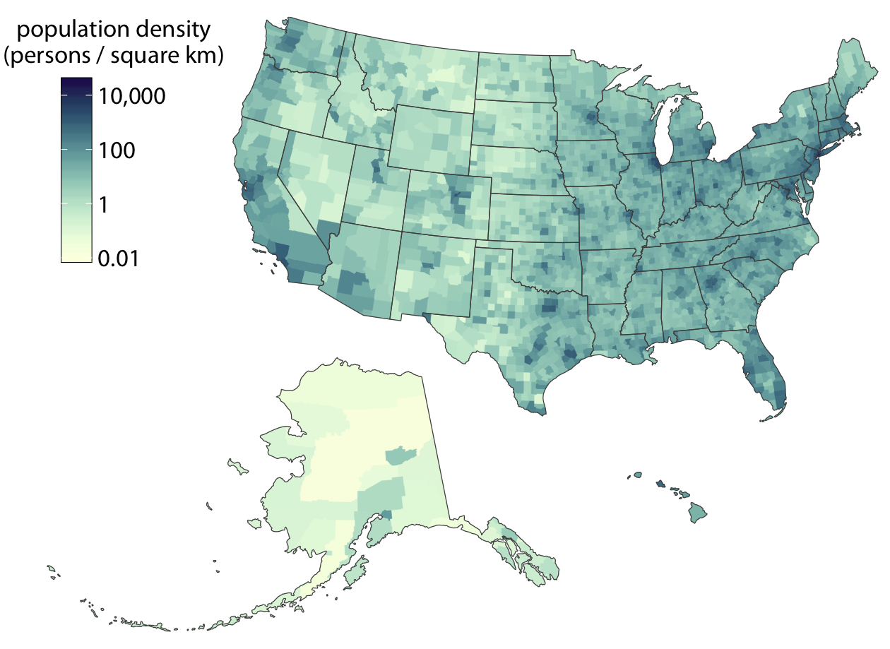
Choropleth Mapping
Choropleth maps: Coloring individual regions in a map according to the data dimension we want to display.
Population density for US counties.
Notes:
As long as the lighter colors fall into the red-yellow spectrum, so that they appear to be glowing, they can be perceived as representing higher intensities. As a general principle, when figures are meant to be printed on white paper, light-colored background areas (as in Figure 15-11) will typically work better. For online viewing or on a dark background, dark-colored background areas (as in Figure 15-12) may be preferable.

Slide 15
Notes on Choropleth
Works best when the coloring represents a density (i.e., some quantity divided by surface area)
We often see choropleths colored according to some quantity that is not a density.
Needs caution as the size may convey unintended message

Slide 16
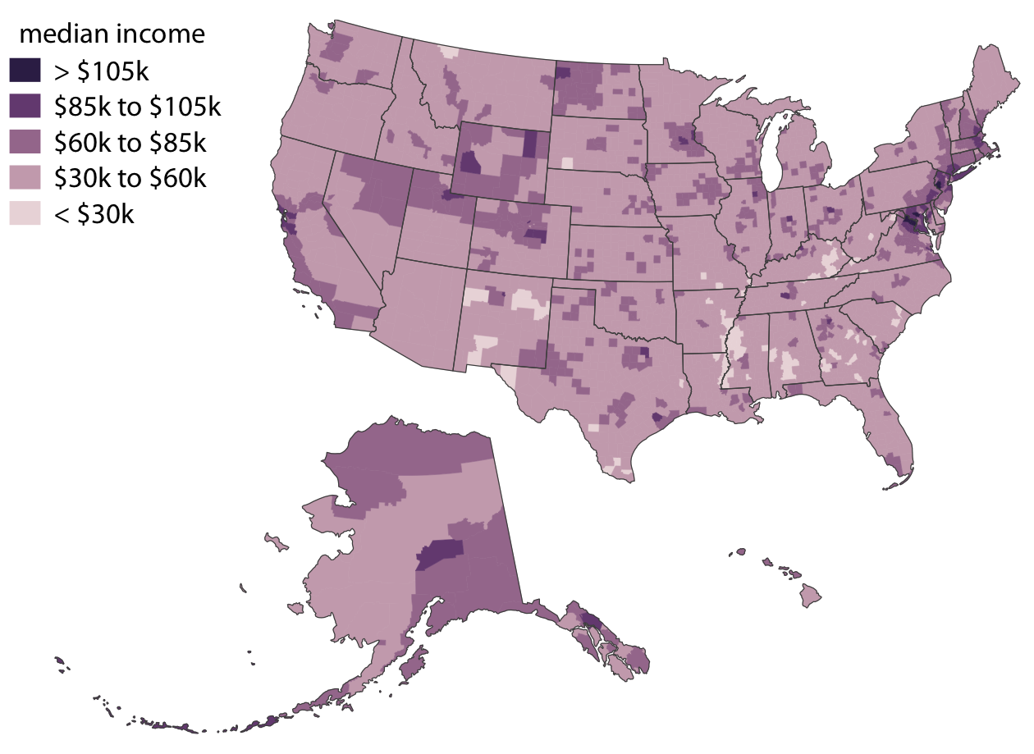
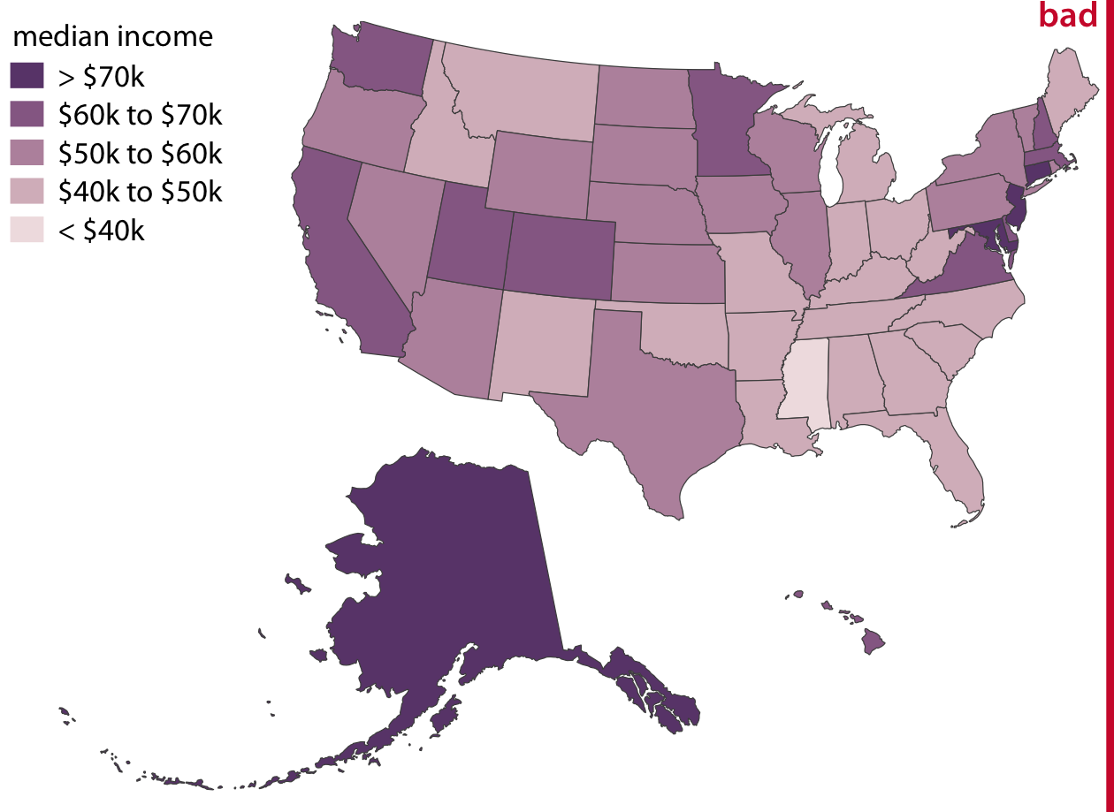
Continuous vs. discrete color scales
While continuous color scales tend to look visually appealing, they can be difficult to read.
County level
State level

Slide 17
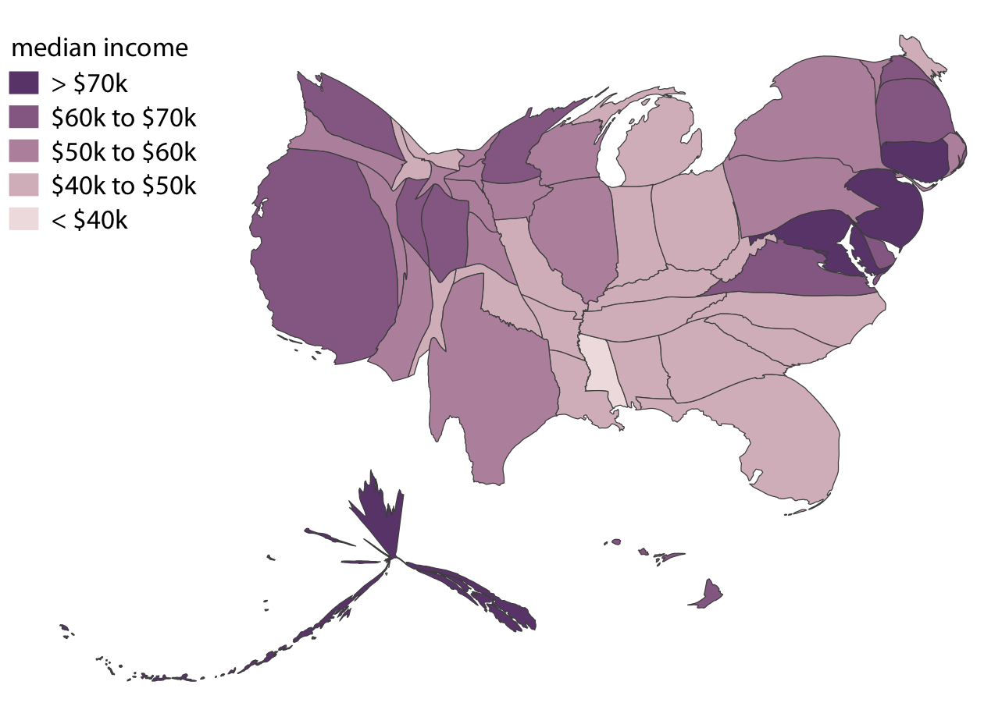
Cartograms
Not every map-like visualization has to be geographically accurate to be useful.
What if we deformed the states so their size was proportional to their number of inhabitants?

Slide 18
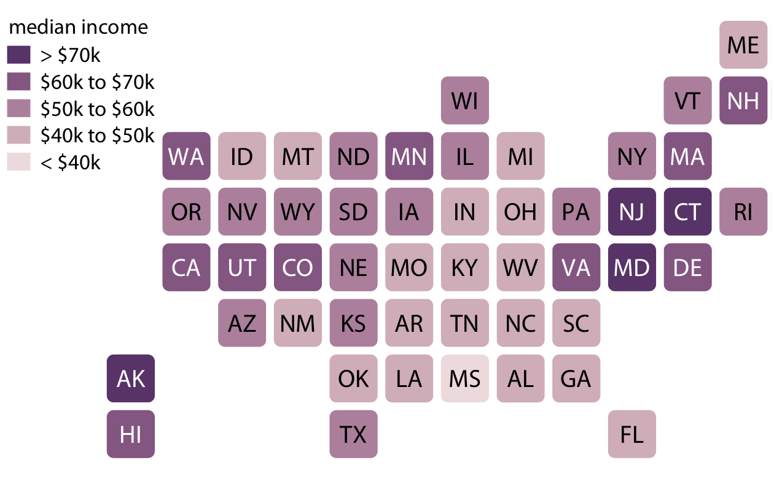
Cartogram heatmap
E.g., each state is represented by a colored square.
Does not correct for the population number in each state, and thus underrepresents (overrepresents) more (less) populous states
Treats all equally and doesn’t weight them arbitrarily by their shape or size.

Slide 19
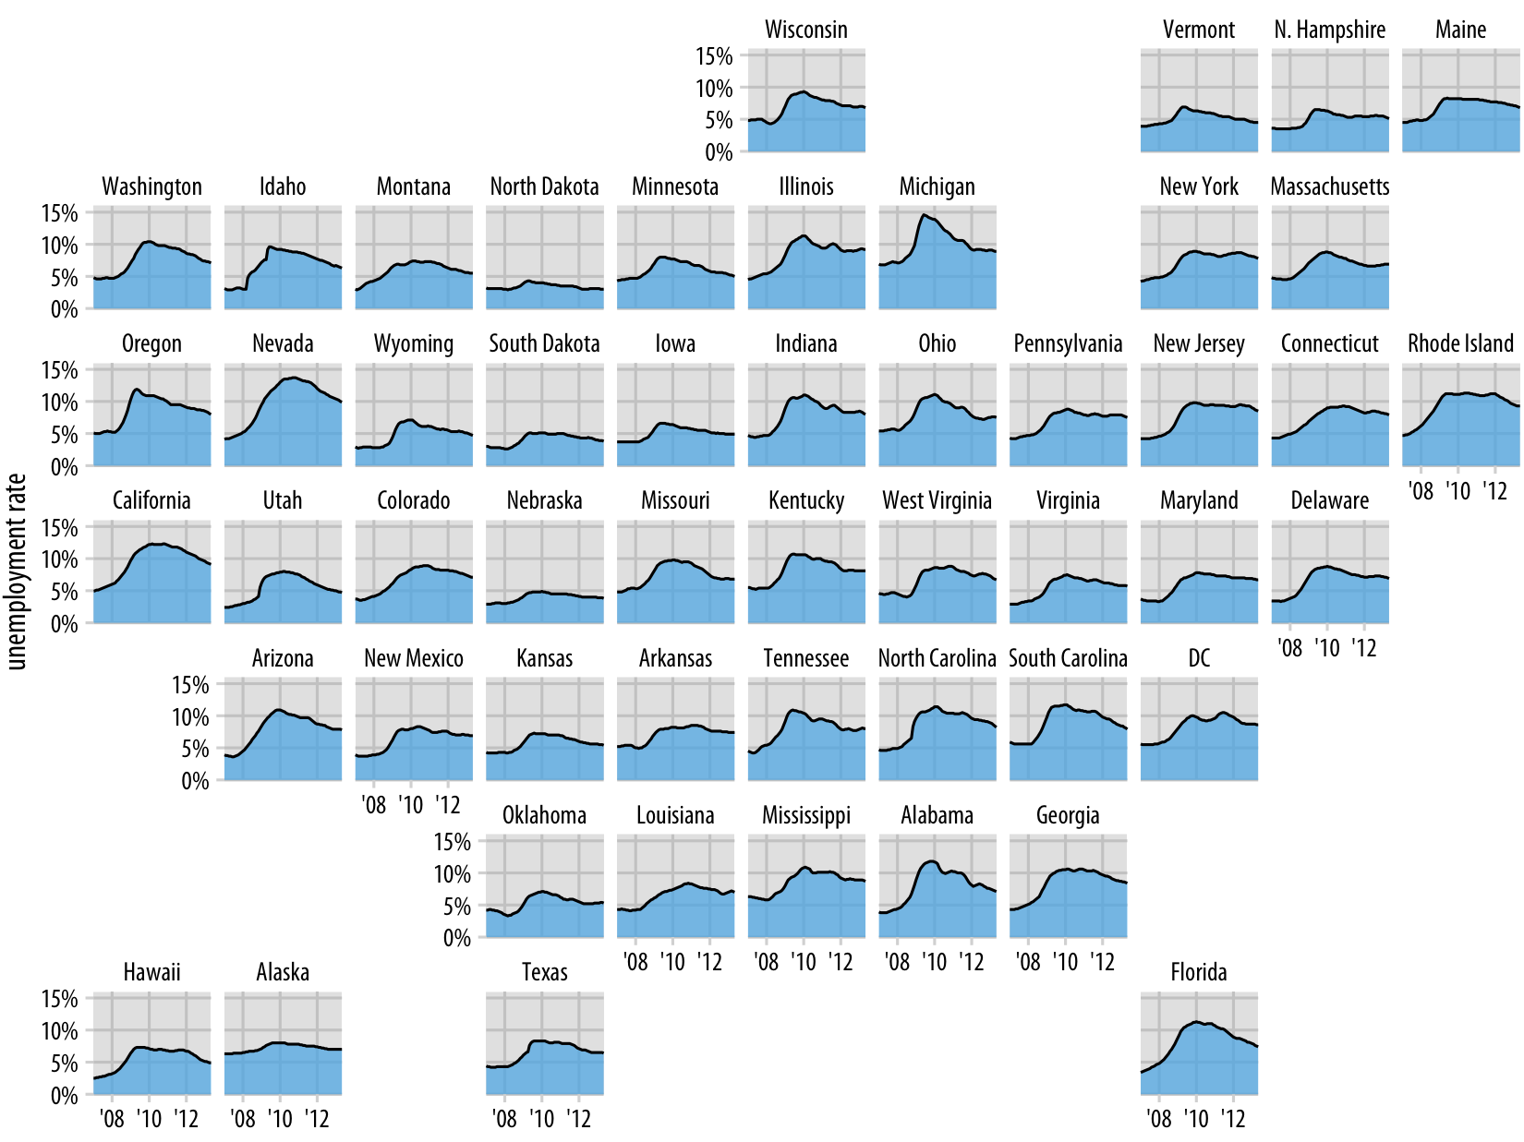
Ex. Unemployment rate over time
Draw an individual graph for each state
Arrange based on the approximate relative positions
If you’re familiar with US map, better than alphabetical order

